Slide 1
Recommender Systems and the next-generation Web

Slide 2




New opportunities
More types of information available
More willingness of users to contribute
New application areas
Friends, pictures, movies, tags, bookmarks

Slide 3
Web 2.0
Web users connect via social networks
Publish their demographic characteristics and preferences
Actively provide and annotate resources such as images or videos
Share their knowledge in community platforms
New types of public information spaces
Web logs (blogs)
Wikis
Platforms for sharing multimedia resources
New capabilities of Web 2.0 greatly influence the field of recommender systems

Slide 4
RS and the Social Web
The Web 2.0 / Social Web
Facebook, Twitter, Flickr, …
People actively contribute information and participate in social networks
Impact on recommender systems
More information about user's and items available
Demographic information about users
Friendship relationships
Tags on resources
New application fields for RS technology
Recommend friends, resources (pictures, videos), or even tags to users
=> Requires the development of new algorithms
=> Currently, many papers published on this topic

Slide 5
Trust-aware recommender systems (TARS)
Trust in recommender systems
Get users to believe that the recommendations made by the system are correct and fair
Assess the "trustworthiness" of users to discover and avoid attacks on recommender systems
Trust relationships between users (our focus)
Trust-enhanced nearest-neighbor recommender systems
Exploit trust networks to improve the system performance
The accuracy of the recommendations can be increased
Alleviate the cold-start problem
Improve on the user coverage

Slide 6
Trust-aware recommender systems (TARS)
Explicit trust statements between users
Can be expressed on some social web platforms (epinions.com)
Could be derived from relationships on social platforms
Trust is a multi-faceted, complex concept
Goes however beyond an "implicit" trust notion based on rating similarity
Exploiting trust information in RS
To improve accuracy (neighborhood selection)
To increase coverage
Could be used to make RS robust against attacks

Slide 7
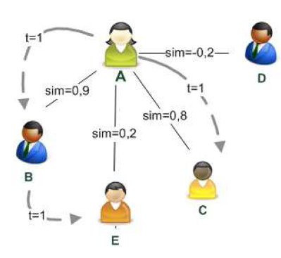
TARS (Massa & Avesani 2007)
Input
Rating matrix
Explicit trust network (ratings between 0 – no trust, and 1 – full trust)
Prediction
Based on usual weighted combination of ratings of the nearest neighbors
Similarity of neighbors is however based on the trust value
Note
Assume standard Pearson CF with min. 3
peers and similarity-threshold = 0.5
No recommendation for A possible
However, assuming that trust is transitive and 3 trusted users are sufficient, then the rating of E could be used
Good for cold-start situations
Limit transitivity

Slide 8
Trust metrics and effectiveness
Experiments on an Epinions.com dataset
Effectiveness of simple algorithms
Simple algorithms such as "always predict value 5" or "always predict the mean rating value of a user" (Many 5-star ratings in the dataset)
Predict average rating of items, good results for cold-start users. However, for controversial items CF outperforms simple algorithms
Using direct trust only
Uses only the opinions of users for which an explicit trust statement is available
Works well for cold-start users, niche items and opinionated users (have a high standard deviation in their ratings),
Best method with respect to mean absolute user error (MAUE) MAUE: compute the mean error for each user and then average these user errors over all the users. Errors of cold-start users are as influential as errors for heavy rater
However coverage is below CF

Slide 9
Trust metrics and effectiveness (cont.)
Trust propagation
Increasing propagation distance leads to an increase in rating coverage but decreases prediction accuracy
Hybrids
Such a combination quite intuitively leads to increased coverage but the performance did not increase

Slide 10
RS, social networks and trust
Hybrids
Information from various sources might be combined to generate personalized information services (Hess et al. 2006), i.e. combine trust networks of researchers and visibility of scientific papers
Implicit trust
One will ask friends who have similar tastes for a recommendation.
Trustworthiness is measured by how often a user has been a reliable predictor in the past (Massa and Avesani 2007)
Recommending new friends
Another form of cold-start problem
Many of today's social web platforms aim to increase the connectivity of their members by suggesting other users as friends, e.g. "close a trust triangle" by similarity measures

Slide 11
Folksonomies
Folk taxonomies
Users add tags to resources (such as images)
Tags can describe different aspects of a resource such as content, genre but also personal impressions such as boring
Folksonomies are based on freely-used keywords (e.g. on flickr.com)
Not as formal as ontologies, but more easy to acquire
Semantic Web approaches
Formal, defined, and machine-processible annotations
Formal ontologies have the advantages of preciseness and definedness, they are hard to acquire
Recommender systems and folksonomies
Exploit the information of how items are tagged by the community
Recommend tags to users

Slide 12
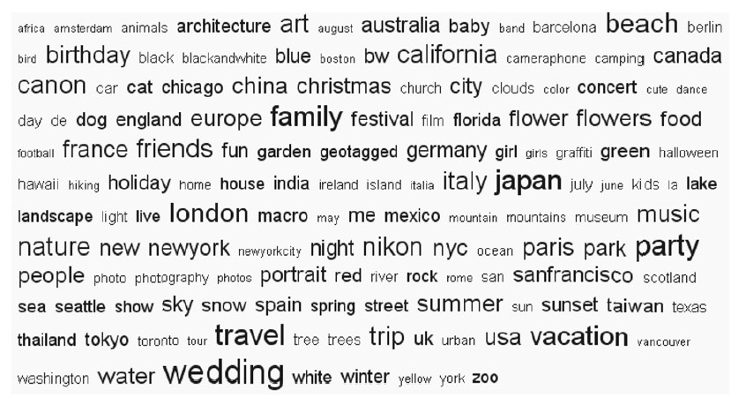
Folksonomies and content-based methods
Recommendations based on tag clouds
Linguistic methods for tag-based recommendation
merge tags assigned by users to descriptions in special slots (Gemmis et al. 2008)

Slide 13
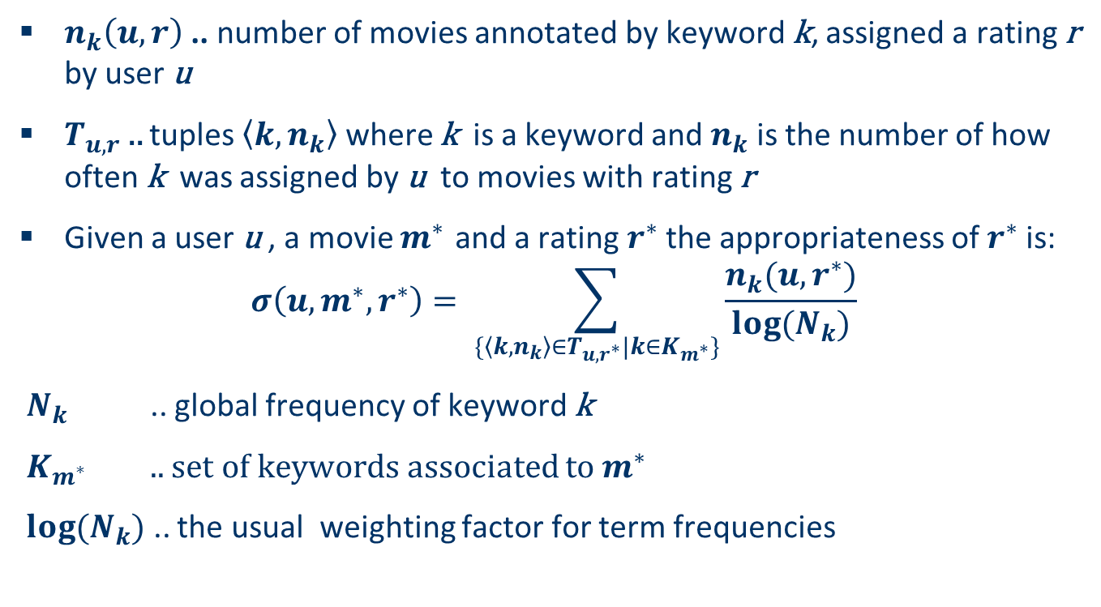
Recommendations based on tag clouds
$n_{k}\left(u,r\right)$ .. number of movies annotated by keyword k, assigned a rating r by user u
$T_{u,r}$ .. tuples $\left\langle k,n_{k}\right\rangle$ where k is a keyword and $n_{k}$ is the number of how often k was assigned by u to movies with rating r
Given a user u , a movie $m^{∗}$ and a rating $r^{∗}$the appropriateness of $r^{∗}$is:
$$σ\left(u,m^{∗},r^{∗}\right)= \sum_{\{\left\langle k,n_{k}\right\rangle ∈T_{u,r^{∗}}|k∈K_{m^{∗}}\}}{\frac{n_{k}(u,r^{∗})}{log⁡(N_{k})}}$$
$N_{k}$ .. global frequency of keyword k
$K_{m^{∗}}$ .. set of keywords associated to $m^{∗}$
$log⁡(N_{k})$ .. the usual weighting factor for term frequencies

Slide 14
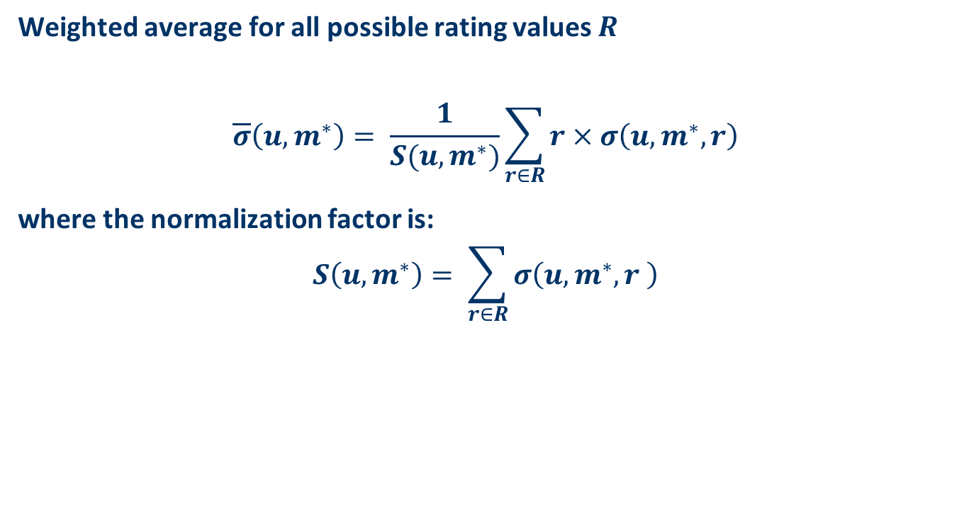
Recommendations based on tag clouds (cont.)
Weighted average for all possible rating values $R$
$$\overline{σ}\left(u,m^{∗}\right)= \frac{1}{S(u,m^{∗})}\sum_{r∈R}{r×σ\left(u,m^{∗},r\right)}$$
where the normalization factor is:
$$S\left(u,m^{∗}\right)= \sum_{r∈R}{σ\left(u,m^{∗},r \right)}$$

Slide 15
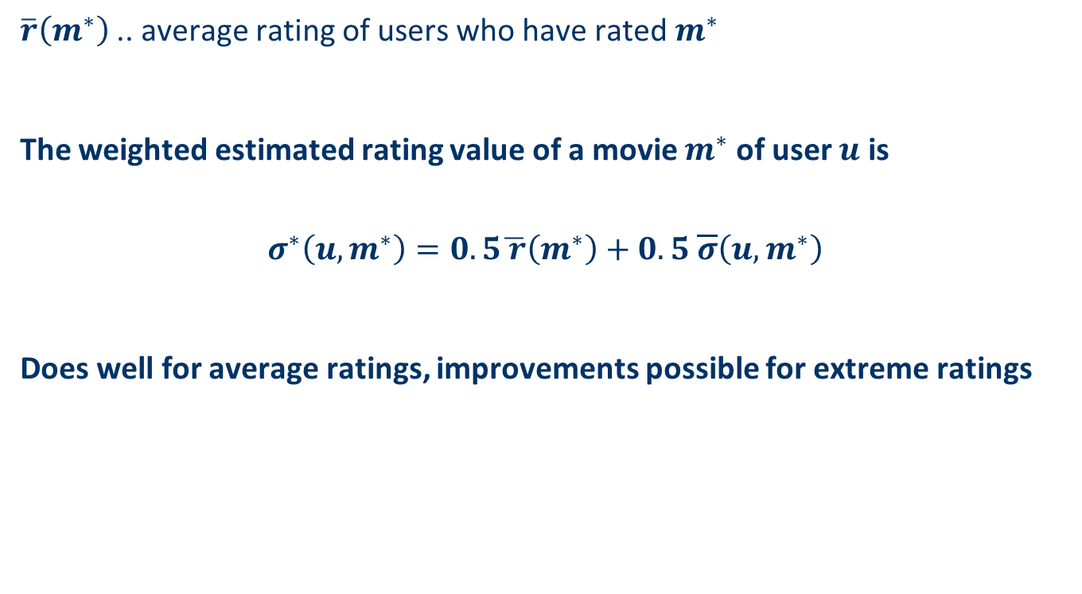
Recommendations based on tag clouds (cont.)
$\overline{r}\left(m^{∗}\right)$ .. average rating of users who have rated $m^{∗}$
The weighted estimated rating value of a movie $m^{∗}$ of user $u$ is
$$σ^{∗}\left(u,m^{∗}\right)=0.5\overline{ r}\left(m^{∗}\right)+0.5 \overline{σ}\left(u,m^{∗}\right)$$
Does well for average ratings, improvements possible for extreme ratings

Slide 16
Linguistic methods for tag-based recommendation
(Gemmis et al. 2008)
Items are described by static slots, e.g. title, painter
In addition so called dynamic slots SocialTags(I) and PersonalTags(U,I) are added I is an item, U is a user
SocialTags(I): tags added to I
PersonalTags(U,I): tags added by user U to I
Words in slots are replaced by synsets (synonymy set) exploiting WORDNET
Word sense disambiguation methods are applied
Slots contain a set of synsets (semantic tags)
Finally, a Bayesian approach is applied for predicting the user rating exploiting the values of the slots

Slide 17
Folksonomies and collaborative filtering methods
Tag-enhanced "classical " collaborative filtering methods
View tags as additional information for discovering similarities between users and items
For example, Tso-Sutter et al. (2008) viewed tags as additional attributes providing background knowledge
Tag-based collaborative filtering and item retrieval
Social ranking (Zanardi and Capra 2008), a method that aims to determine a list of potentially interesting items in the context of a user query
Social ranking aims to overcome this problem by applying traditional CF ideas in a new way
Use user and tag similarities to retrieve a ranked list of items for a given user query

Slide 18
Tag-enhanced collaborative filtering
Difference to content-boosted CF
Tags/keywords are not "global" annotations, but local for a user
Possible approach, a combined, tag-aware CF method
Remember, in user-based CF
Similarity of users is used to make recommendations
Here, view tags as additional items (0/1 rating, if user used a tag or not); thus similarity is also influenced by tags
Likewise, in item-based CF, view tags as additional users (1, if item was labeled with a tag)
Predictions
Combine user-based and item-based predictions in a weighted approach
Experiments show that only combination of both helps to improve accuracy

Slide 19
Tag-based CF and item retrieval
Item retrieval in Web 2.0 applications
Often based on overlap of query terms and item tags
Insufficient for retrieving the "long tail" of items
Users may use different terms in their annotations
Think of possible tags of a car, "Volkswagen", "beetle", "red", "cool"…
One approach, Social Ranking
Use CF methods to retrieve ranked list of items for given query
Compute user and tag similarities (e.g., based on co-occurrence)
Two-phase retrieval
Extend user query with similar tags (improves coverage)
Rank items based on
Relevance of tags to the query
Similarity of taggers to the current user
Leads to measurably better coverage and long-tail retrieval

Slide 20

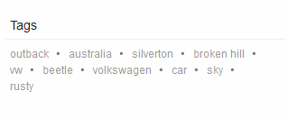
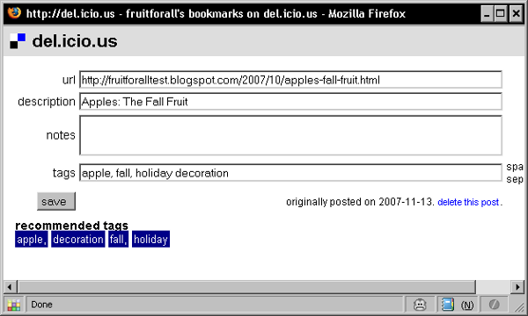
Recommending tags

Slide 21
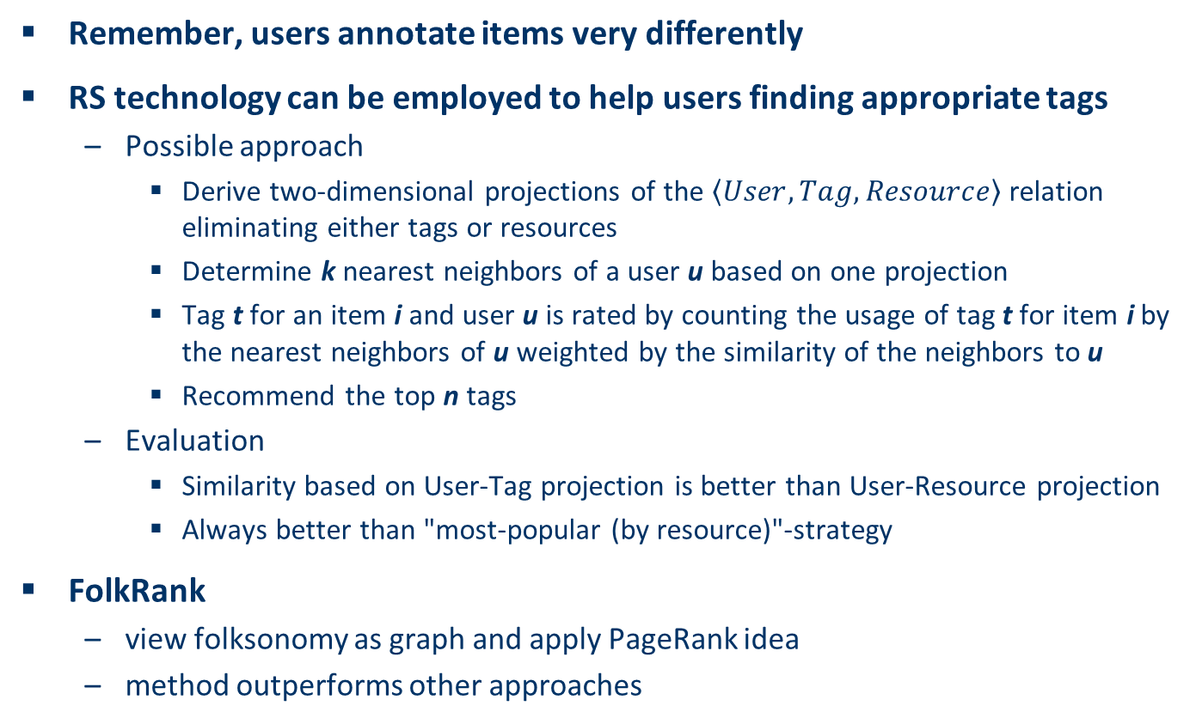
Recommending tags
Remember, users annotate items very differently
RS technology can be employed to help users finding appropriate tags
Possible approach
Derive two-dimensional projections of the $\left\langle User,Tag,Resource\right\rangle$ relation eliminating either tags or resources
Determine k nearest neighbors of a user u based on one projection
Tag t for an item i and user u is rated by counting the usage of tag t for item i by the nearest neighbors of u weighted by the similarity of the neighbors to u
Recommend the top n tags
Evaluation
Similarity based on User-Tag projection is better than User-Resource projection
Always better than "most-popular (by resource)"-strategy
FolkRank
view folksonomy as graph and apply PageRank idea
method outperforms other approaches

Slide 22
Recommending content in participatory media
Second-generation web, participatory media
Users contribute the content
Exploit information if the active user trusts the content providing person.
(Seth et al. 2008)
Credibility of messages depend on credibility of authors which depends on topics and the active user and the opinion of her friends
Messages are labeled with their authors
Users assign a supposed credibility to messages
Users are explicitly connected with their "friends"
Every user can declare a list of topics in which he or she is interested, i.e. topic specific networks can be generated
Bayesian model predicts if the active user will find a new message credible

Slide 23
Recommending content in participatory media (cont.)
(Guy et al. 2009)
Differentiates users in familiar and similar users w.r.t. active user
Familiar score depends on organizational charts, direct connections in social networks, tagging of persons, co-authorship of content
Similarity score depends on co-usage of tags, co-bookmarking the same web page, co-commenting the same blog entry
Recommendations based on similarity scores and familiarity scores were compared
Explanations in terms of persons who are similar/familiar were given
Recommendations based on familiarity scores outperformed similarity scores (user classified the recommended items as interesting, not interesting, already known)
Effect could be caused by persuasion
Explanations caused an increase of classifying items as interesting

Slide 24
Ontological filtering
Semantic Web community
Describe web resources by languages that can be interpreted by software systems
Match the information need of users by exploiting machine interpretable information, e.g. OWL
Formulate a domain ontology
Apply ontology to improve recommender systems
Knowledge-based techniques such as simple inheritance taxonomies and logical description
These recommender systems are actually hybrid systems
The aim is to leverage their capabilities by knowledge-based methods

Slide 25
Augmentation of filtering
Augmentation of filtering by taxonomies
Hierarchical ontology
"sport" is a parent of "soccer" and a grandparent of "world soccer tournaments"
Use item profile and user profile to annotate news items and let users directly express interests
Augmentation of filtering by attributes
Attributes used to characterize items
In the movie domain, attributes are genre, actors, director, and name
Use semantic information about items (e.g. genere, actor, etc.) to compute similarities between items
Combine semantic similarity and rated similarity to predict user ratings

Slide 26
Example for filtering by taxonomies (Maidel et al. 2008)
Given
Item profile: set of concepts associated to items
User profile: set of concepts associated to users
Taxonomy of concepts (sub-super concept hierarchy, e.g. soccer is a sport)
Compute matching scores between user and item concepts
Various cases: perfect match, parent/child and grandparent/grandchild match e.g. user is interested in sports, item is a member of soccer items
Each match has a score depending on matching case
Compute item/user match depending on the weights of the concepts of the active user and the matching score of user concepts and item concepts
Evaluation
Without concept taxonomy the quality of recommendations drops significantly
If user explicitly states the interest in concepts, quality improves significantly

Slide 27
Extracting semantics from the web
Semantic information can provide valuable means for improving recommendations
Where does this information come from?
How costly and reliable is the acquisition process?
Approaches to generate semantic information
Humans are providing semantics by annotating content and by declaring logical sentences
Develop software systems that are able to generate semantics with little or no human intervention (particularly attractive)

Slide 28
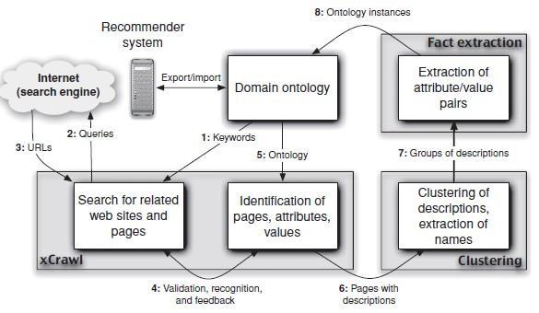
AllRight system (Jannach et al. 2009)

Slide 29
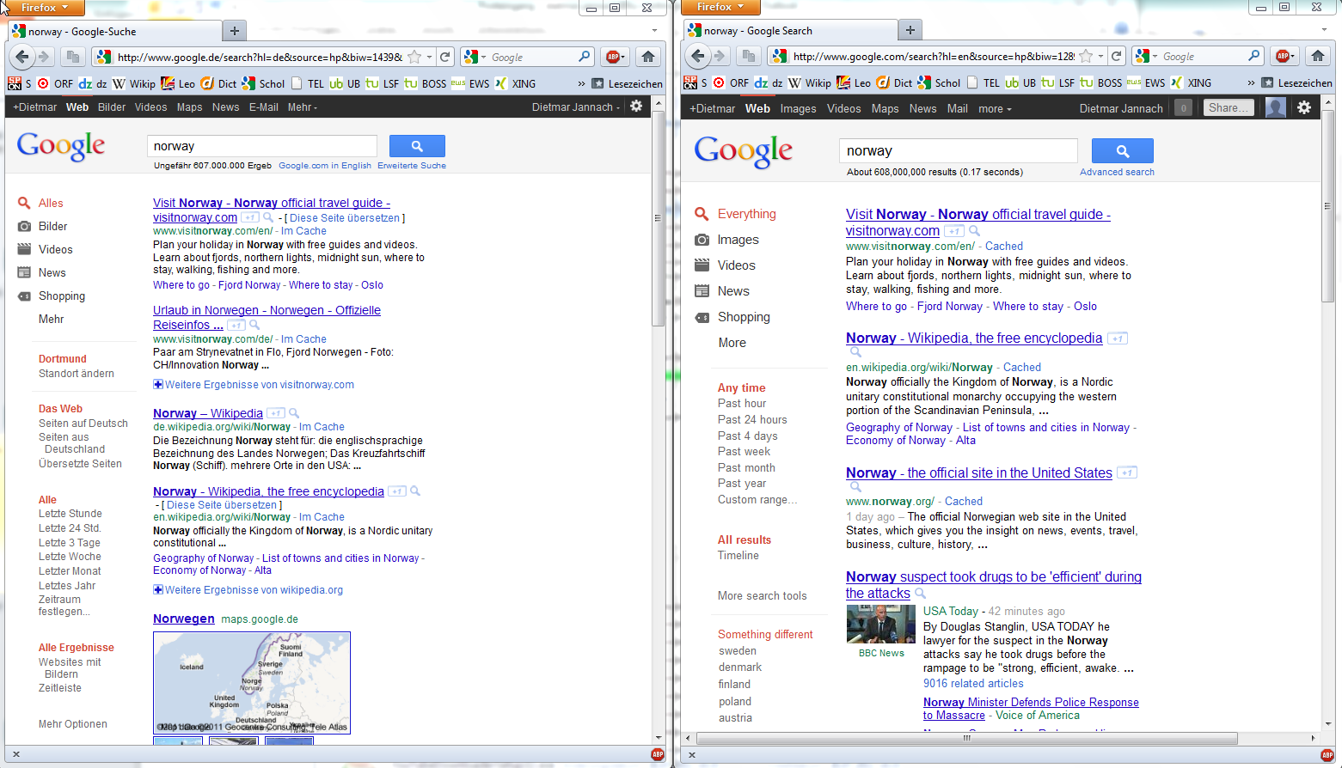
Discussion – The Filter Bubble

Slide 30
Summary
Opportunities, current methods, and realizations of Web 2.0
Semantic Web for recommender systems
Exploit additional information to contribute more trustworthy and qualitative enhanced recommendations
Both Web 2.0 and the Semantic Web in combination not only drive new technologies but have huge impacts on society regarding the communication and interaction patterns of humans
Recommendations shape the users’ behavior in Web++

Slide 31
Literature
[Gemmis et al. 2008] Integrating tags in a semantic content-based recommender, Proceedings of the 2008 ACM Conference on Recommender Systems (RecSys '08), ACM, Lausanne, Switzerland, 2008, pp. 163–170.
[Guy et al. 2009] Personalized recommendation of social software items based on social relations, Proceedings of the 2009 ACM Conference on Recommender Systems (RecSys '09) (New Your, USA), ACM Press, 2009.
[Hess et al. 2006] Trust-enhanced visibility for personalized document recommendations, Proceedings of the 2006 ACMSymposium on Applied Computing (SAC '06) (Dijon, France) (Hisham Haddad, ed.), ACM, 2006, pp. 1865–1869.
[Maidel et al. 2008] Evaluation of an ontology-content based filtering method for a personalized newspaper, Proceedings of the 2008 ACM Conference on Recommender Systems (RecSys '08) (Lausanne, Switzerland), ACM Press, 2008.
[Massa and Avesani 2007] Trust-aware recommender systems, Proceedings of the 2007 ACM Conference on Recommender Systems (RecSys '07) (Minneapolis, MN, USA), ACM Press, 2007.
[Seth et al. 2008] A subjective credibility model for participatory media, Workshop Intelligent Techniques for Web Personalization and Recommender Systems (ITWP) at AAAI '08 (Chicago), AAAI Press, 2008, pp. 66–77.
[Tso-Sutter et al. 2008] Tag-aware recommender systems by fusion of collaborative filtering algorithms, Proceedings of the 2008 ACM Symposium on Applied Computing (SAC'08) (Fortaleza, Ceara, Brazil), ACM, 2008, pp. 1995–1999.
[Zanardi and Capra 2008] Social ranking: Uncovering relevant content using tag-based recommender systems, Proceedings of the 2008 ACM Conference on Recommender Systems (RecSys '08) (Lausanne, Switzerland), ACM Press, 2008, pp. 51–58.

